Slide 1



HCC Analytics
View in Power BI
Last data refresh:
6/3/2019 11:26:06 AM Eastern Standard Time
Downloaded at:
6/3/2019 12:09:05 PM Eastern Standard Time

Slide 2
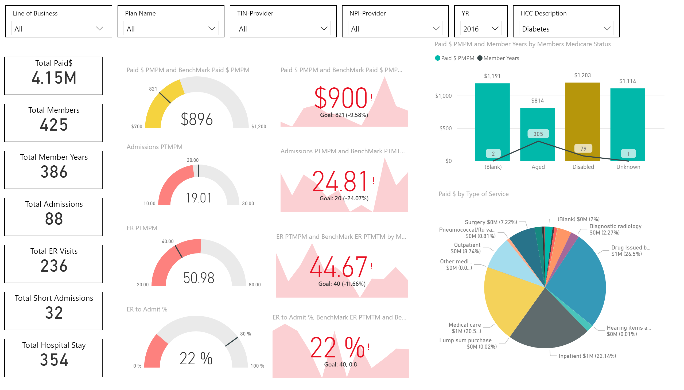

Slide 3
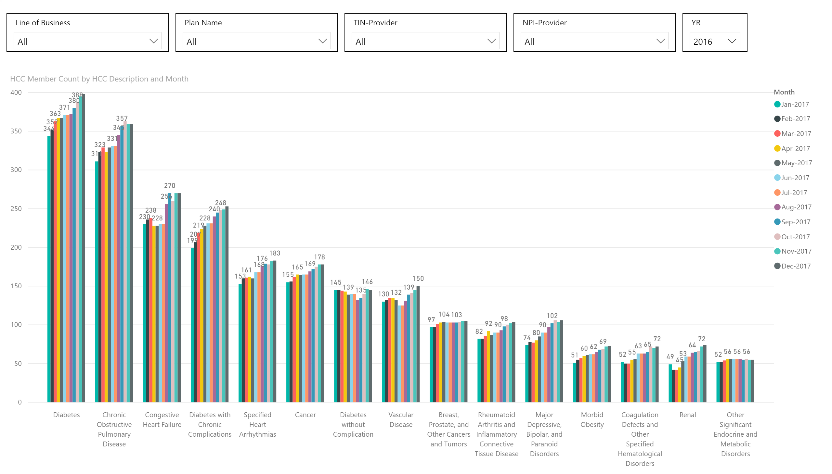

Slide 4
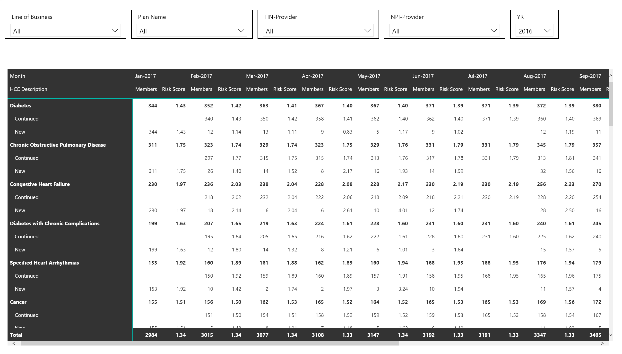

Slide 5
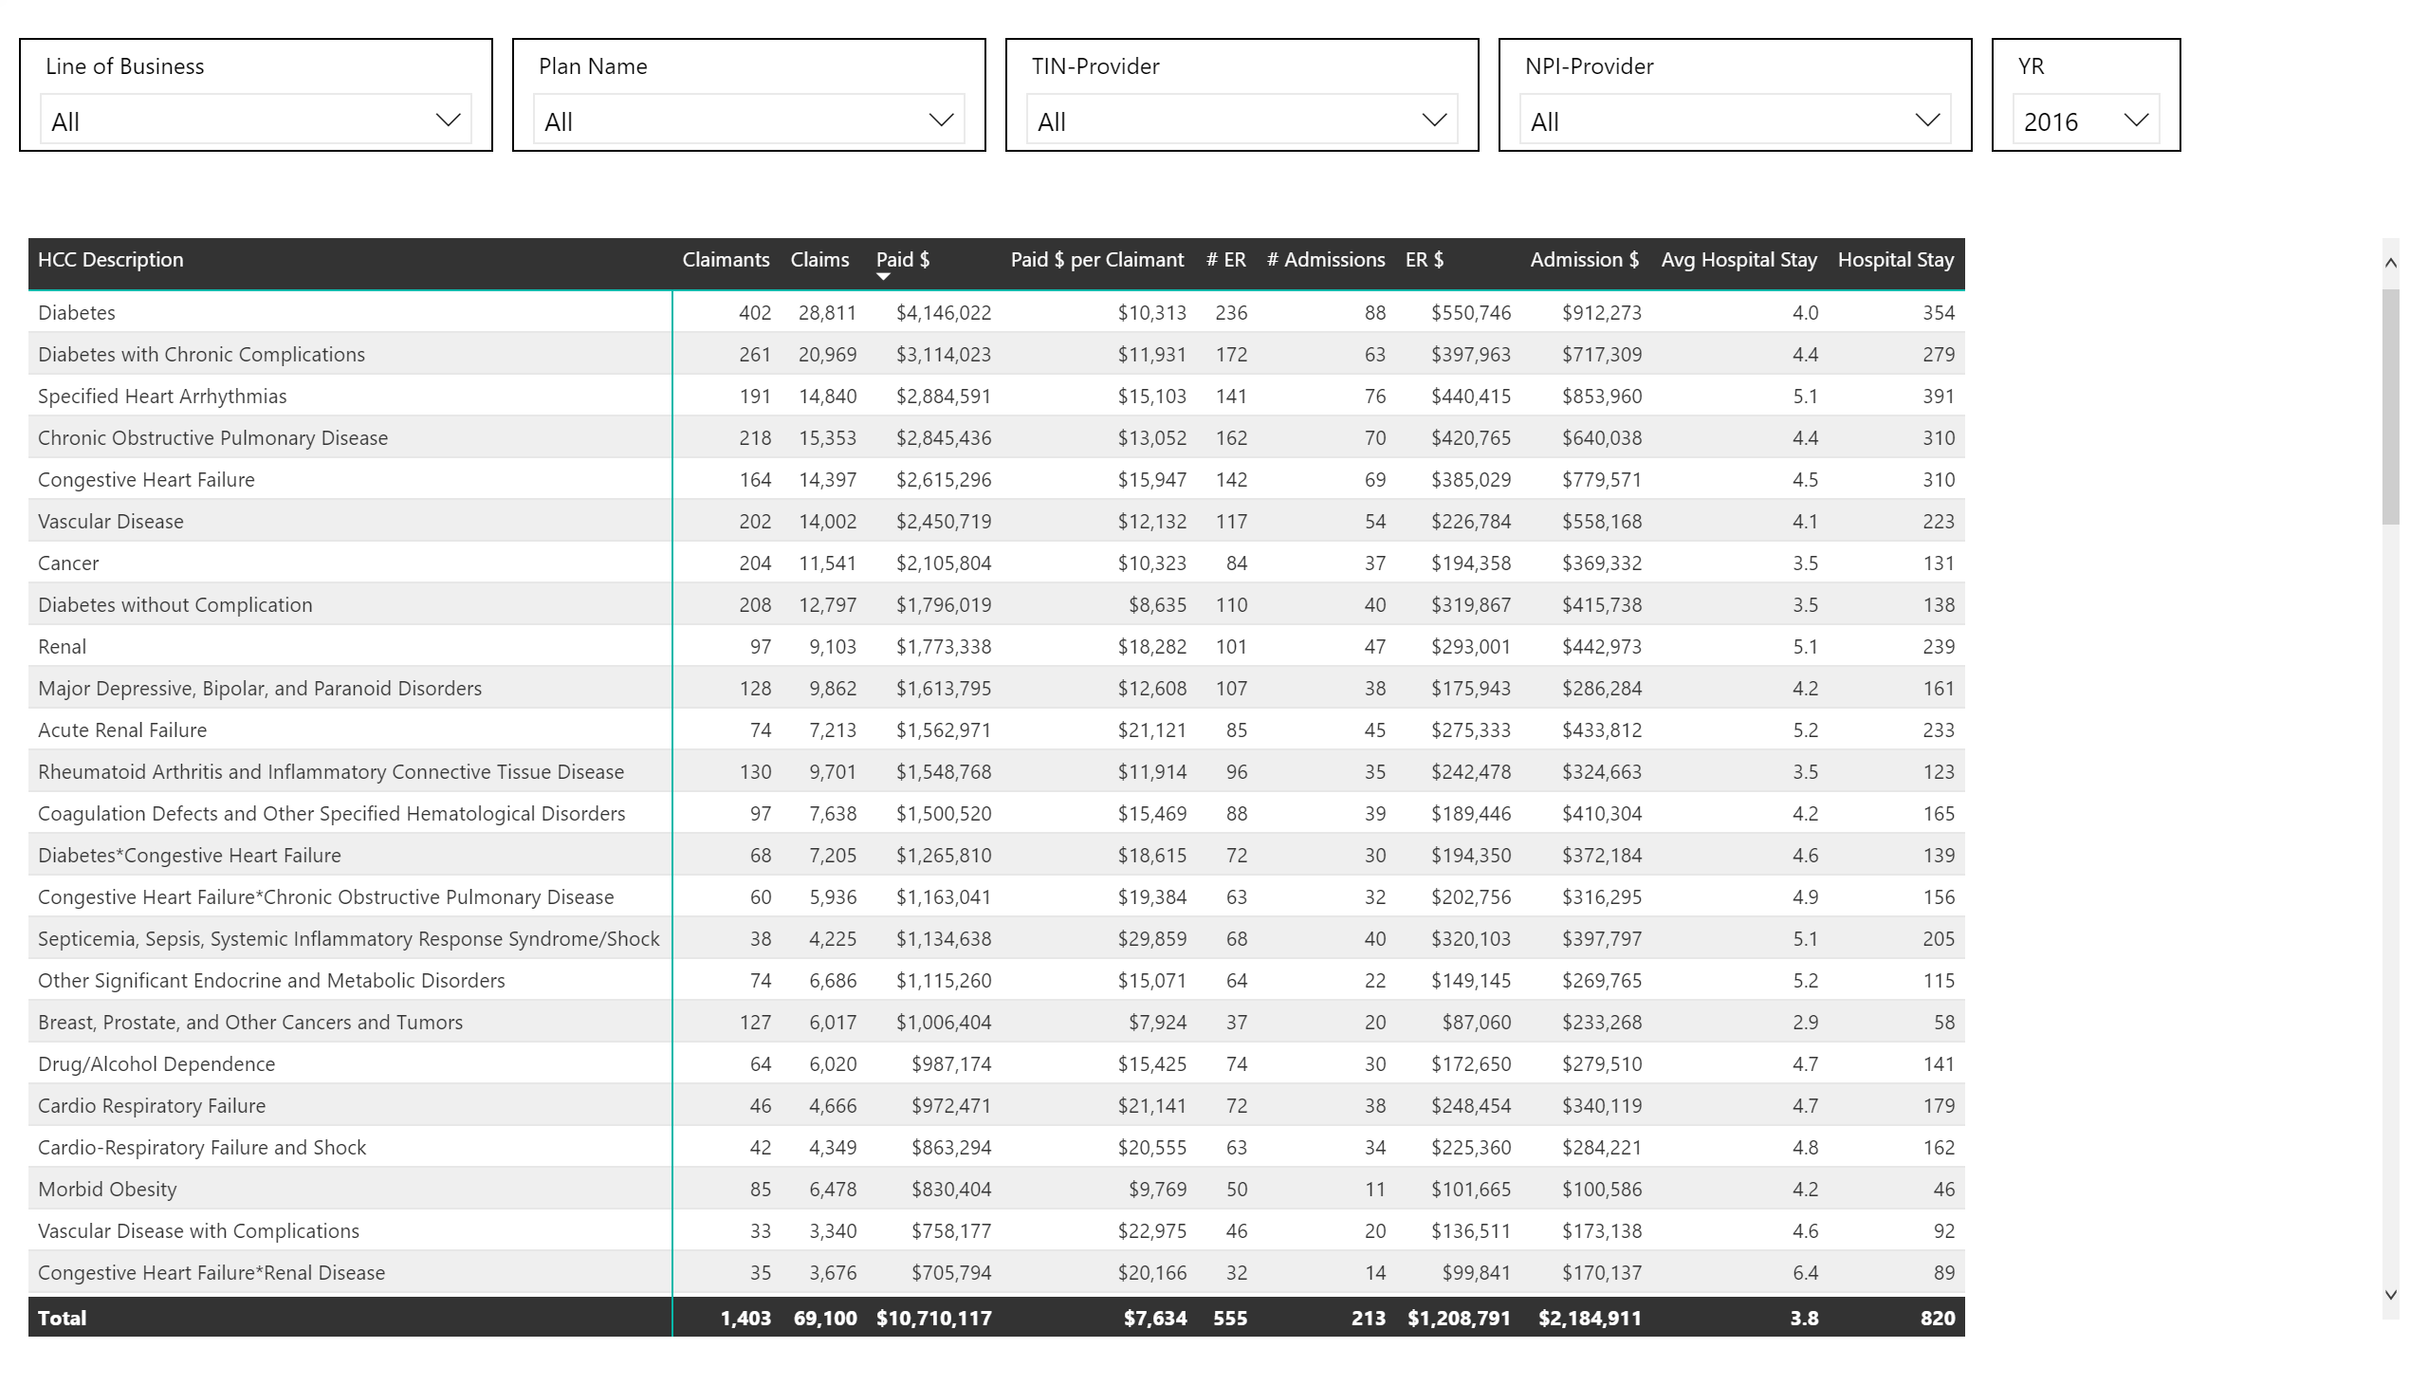

Slide 6
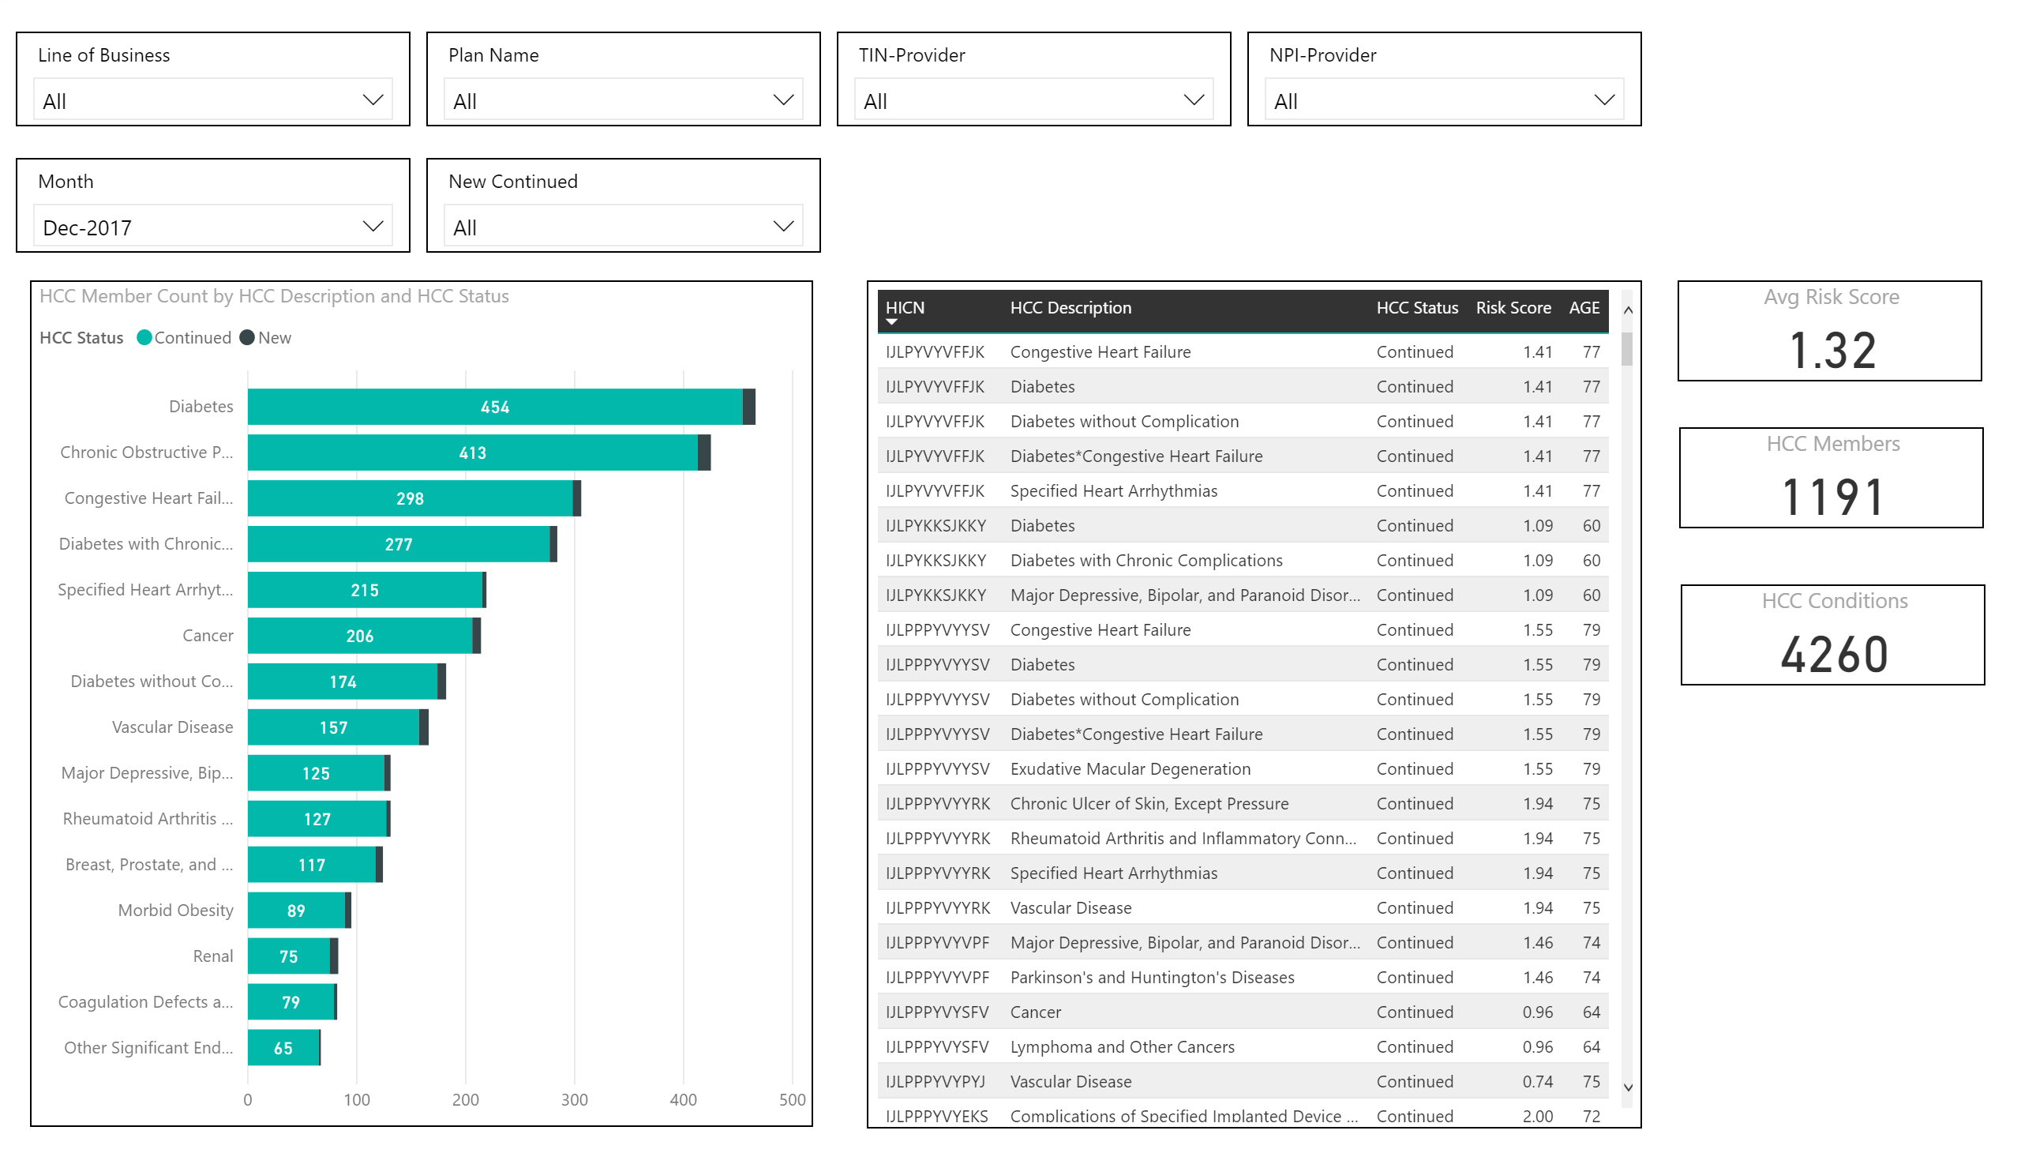

Slide 7
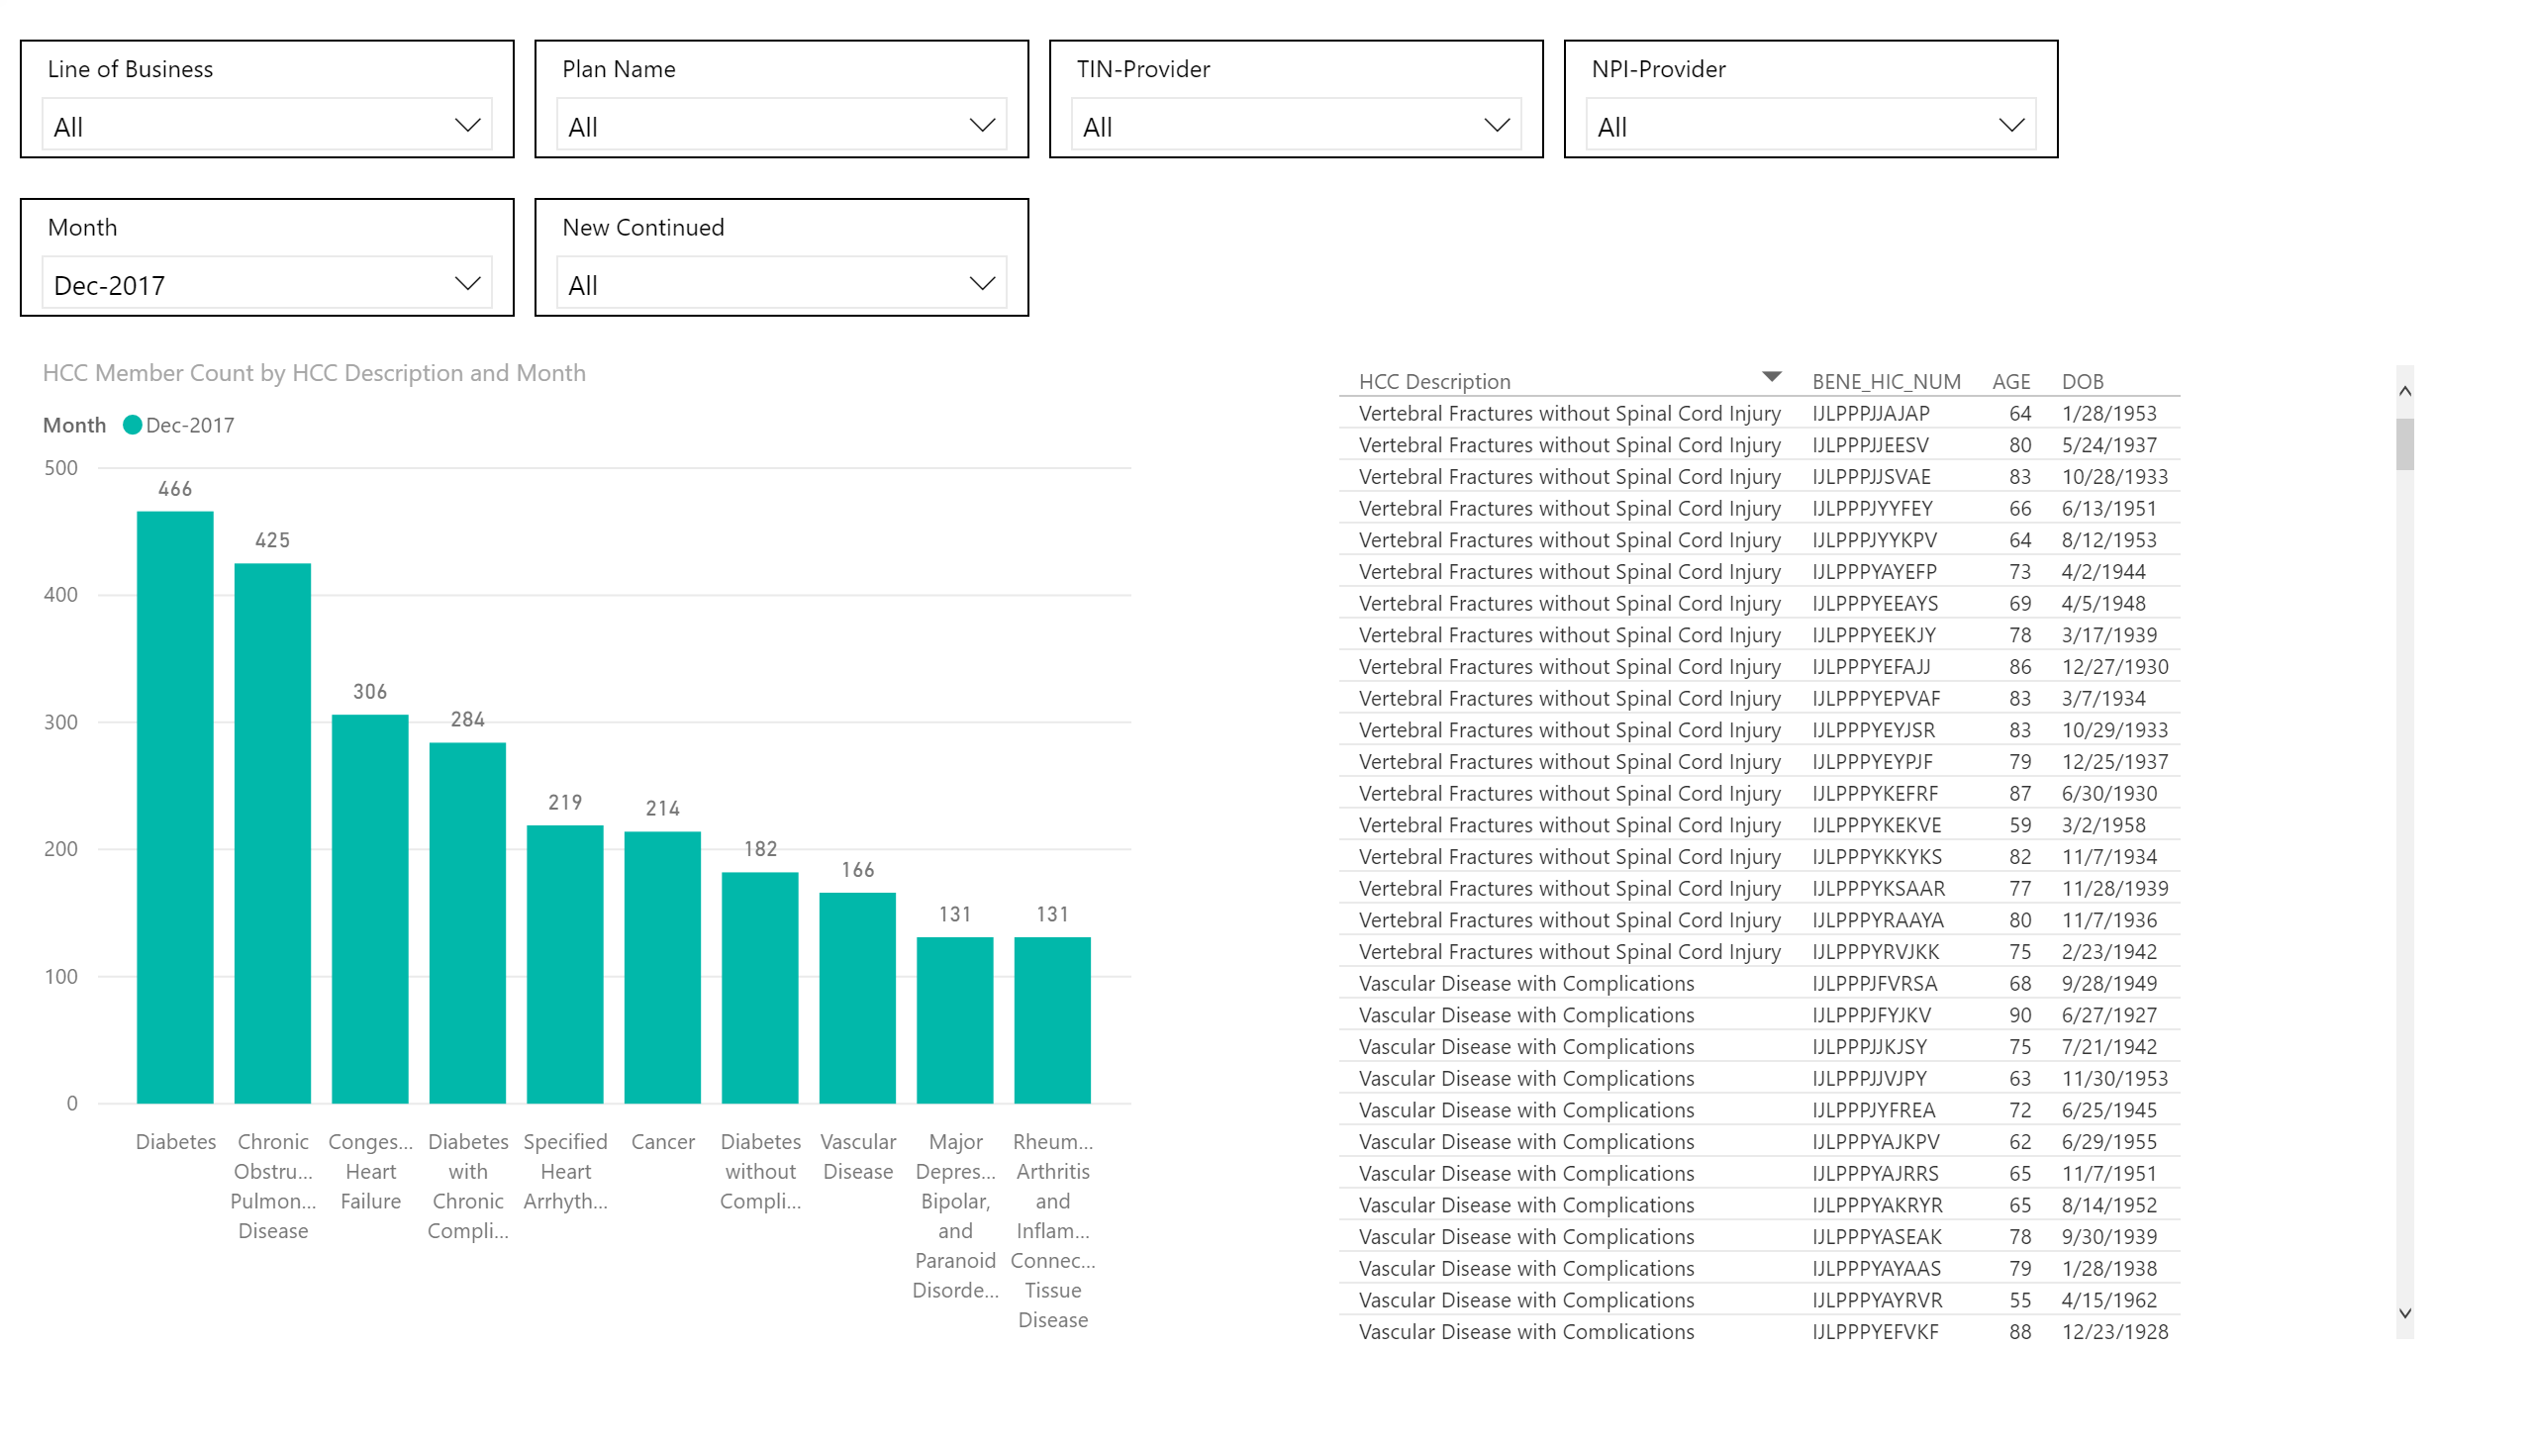

Slide 8
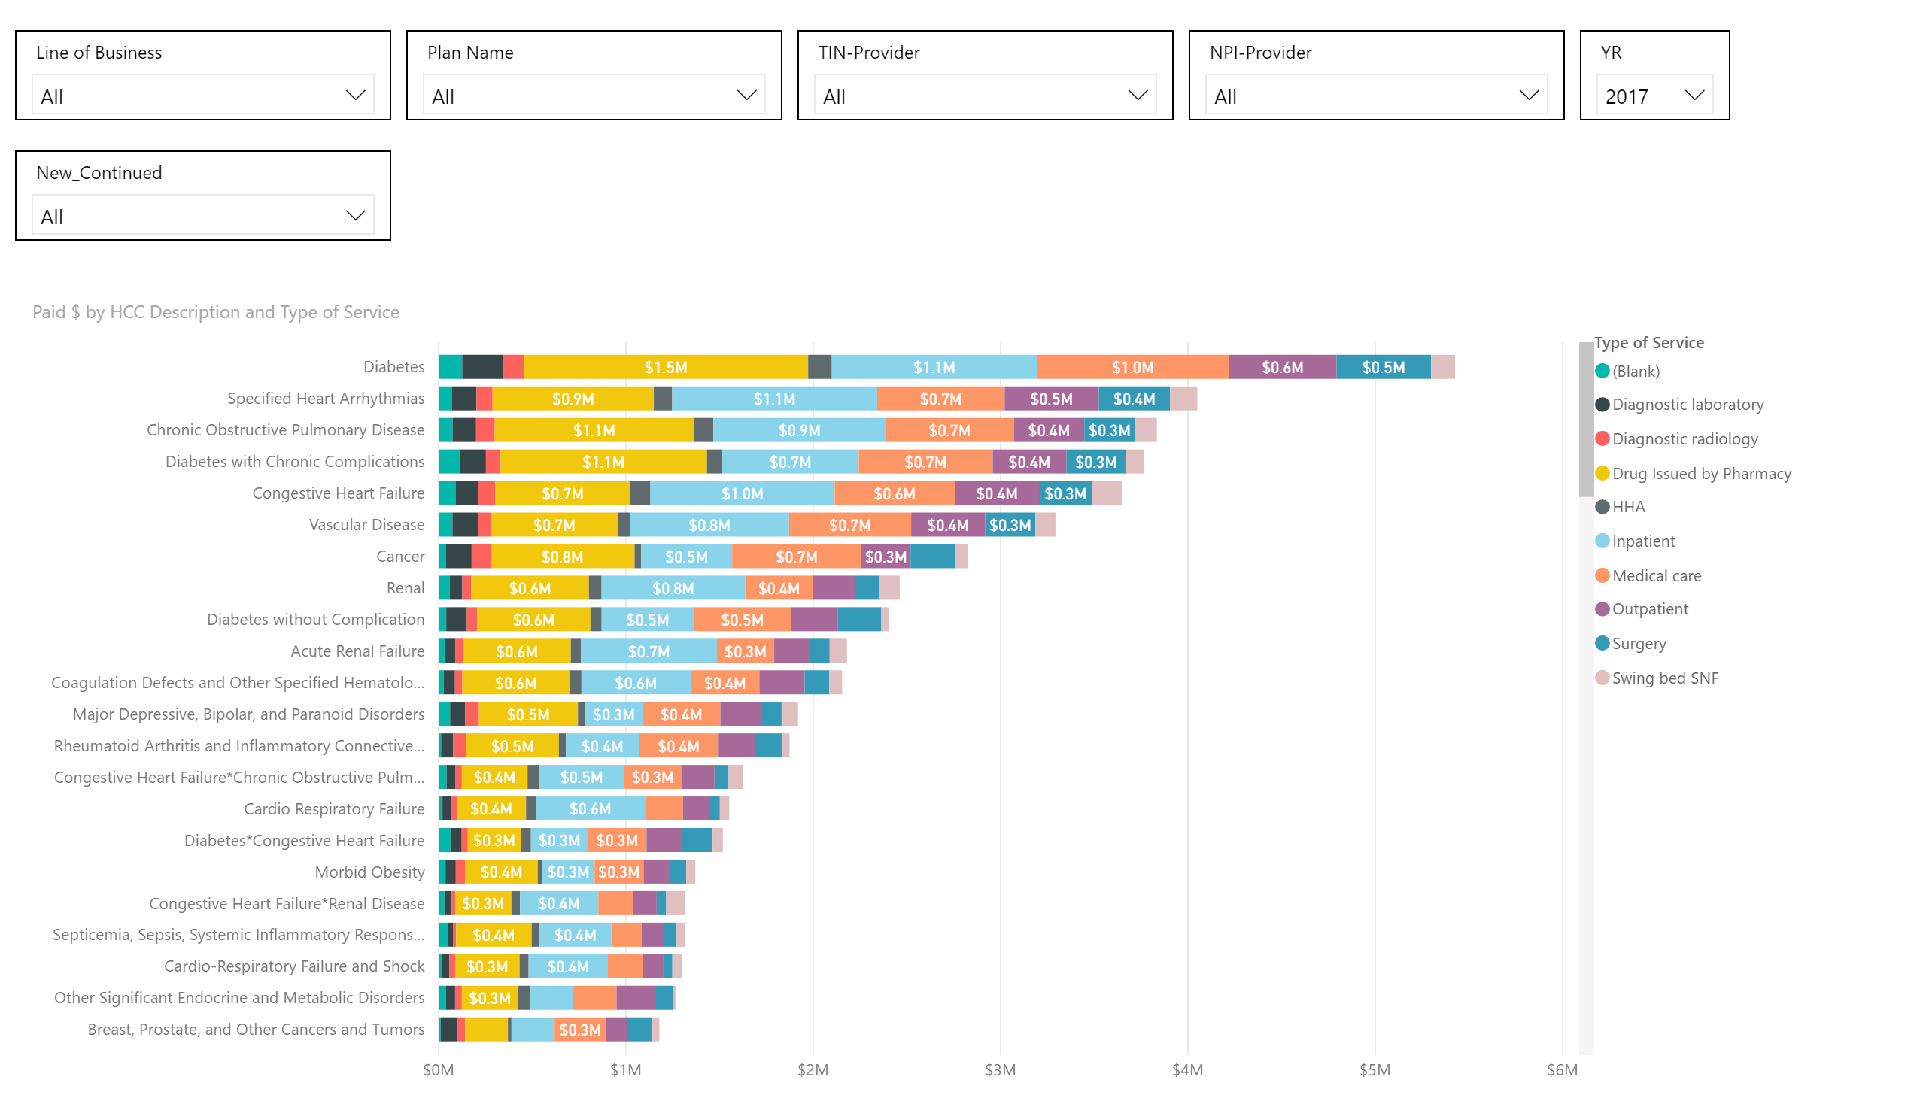

Slide 9
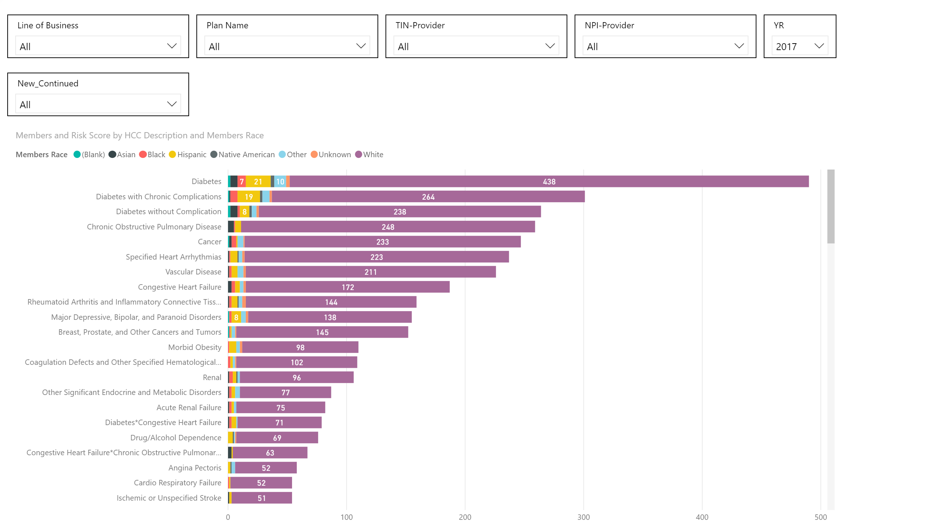

Slide 10
